Slide 1
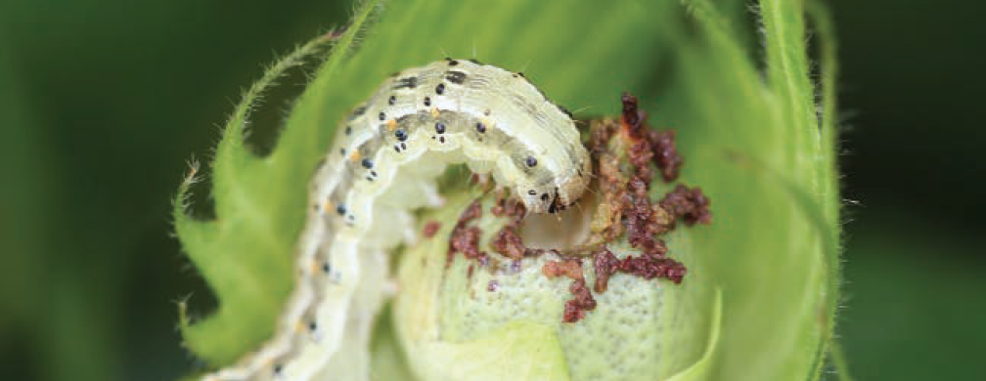
Effect of Bollworm Feeding on Cotton Abscission
Autumn Biggie John Hinic Brennan Clinch
ST 542 (651) Summer 2022

Slide 2
Description/Objectives

Slide 3
Experiment Design

Slide 4
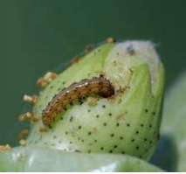
Data Collection

Slide 5
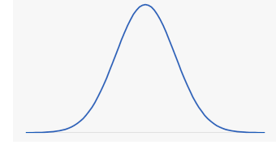
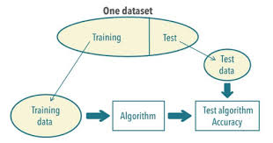

EDA & Data Split
Brennan
Before doing EDA, we took a look at our data to see if there were any things to clean out to make sure we have the most accuracy with our EDA and models
We then performed an exploratory data analysis on our top variables of interest to be able to check the distributions that would help us later with the modeling
Once done with EDA, we split up our data to avoid unnecessary bias
75% of data ~ training, getting models set up and train them
Only doing EDA on this part of the data to remove bias
25% of data ~ testing, seeing how well model performs
By splitting up our data, it will avoid introducing bias, since models should not be evaluated based on how well they predict the data that they have “seen before”

Slide 6
Research Value
Brennan
Our research is important as it will allow our client and his team of researchers to understand what factors have the highest effect on abscission in cotton
It is important that our analysis gives him the best accuracy and results, because after the analysis is complete, he will go on to publish the findings
He will take what we did during this study and then go back into cotton fields to find out what is causing abscission, so our research and practicality/interpretability is one of our highest priorities in this study

Slide 7
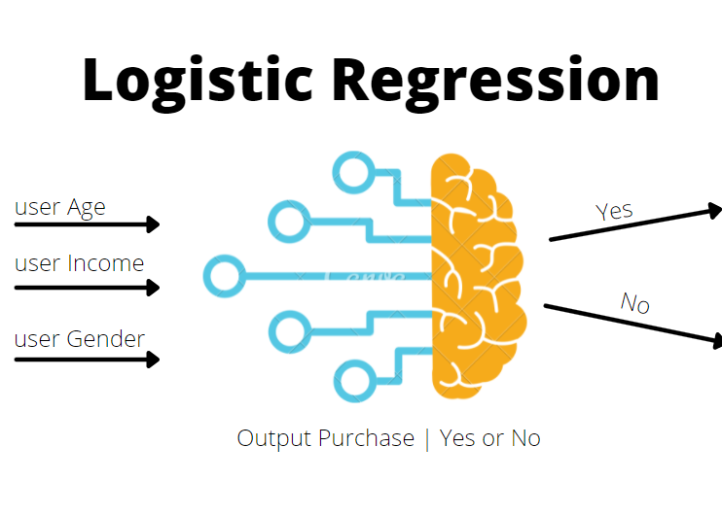
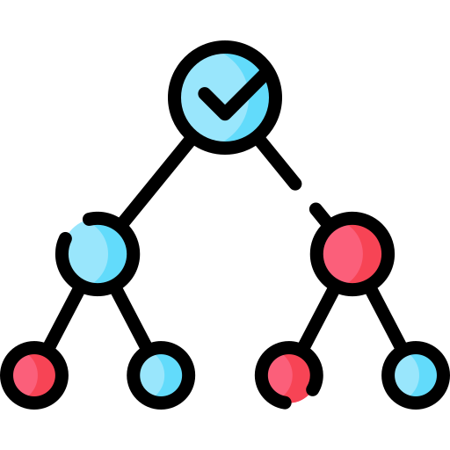
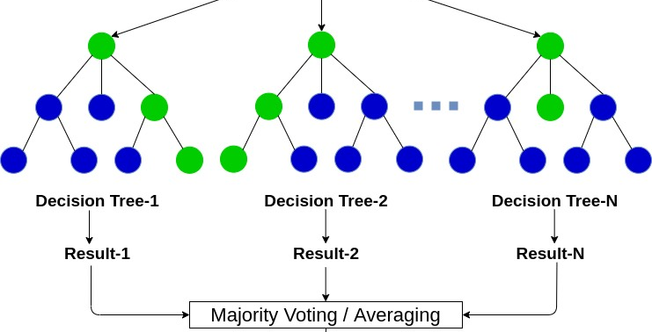

Model Candidates
Logistic Regression
Classification Tree
Boosted Trees
Random Forest
GOAL:
Optimize prediction accuracy while maintaining interpretability

Slide 8
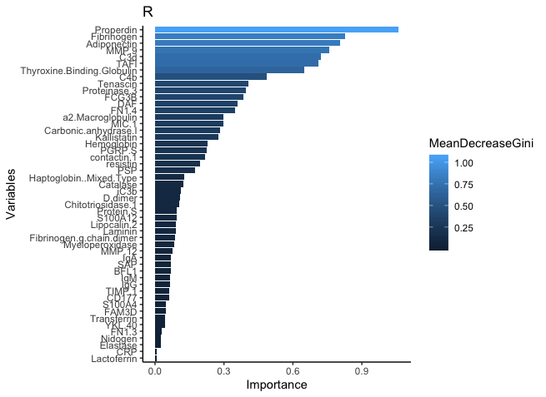
Focus on Interpretability
Find model with best accuracy and interpretability
Identify most important variables

